Slide 1

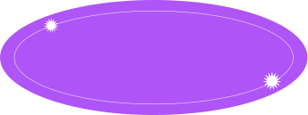

Hello,
My name is Aditi

Slide 2
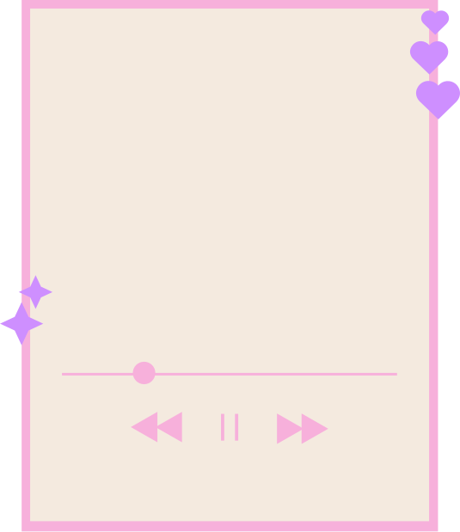

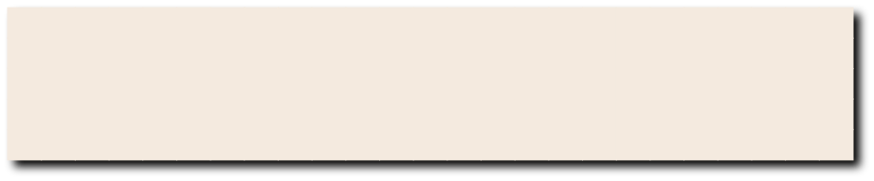
Views

Slide 3
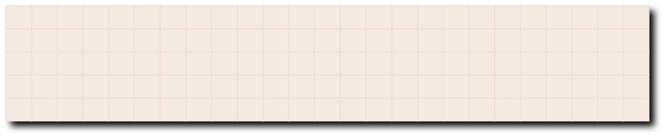

Introduction
VIEWS
WITH CHECK OPTION
INSTEAD TRIGGERS

Slide 4


WHAT IS VIEW?
You create playlists that only show certain types of music, like a "Workout Mix" or a "Chill Vibes" playlist.
People can listen to these playlists, but they can't directly add or remove songs from them.

Slide 5


WITH CHECK OPTION
When you try to add a song to a playlist, it automatically checks if the song belongs in that genre. If it's a rap song on a classical playlist, it gets flagged.

Slide 6
INSTEAD TRIGGERS
You can't directly edit the playlists, but you tell your assistant which song to add (like an INSERT statement).
Checks for genre
Adds it to library
Adds to playlist

Slide 7

SYNTAX
CREATE TABLE Customers (id INT PRIMARY KEY CHECK (id > 0)) (This enforces a check on the id field.)
CREATE TRIGGER AddCustomerTrigger INSTEAD OF INSERT ON Customers ... (This indicates the trigger fires on INSERT statements for the Customers table.)

Slide 8
THANK YOU

